Slide 1

SVPM’s
COLLEGE OF ENGINEERING,
Malegaon (Bk)
DEPARTMENT OF INFORMATION TECHNOLOGY
INTERNSHIP
on
“Data Science ”
By
Sawant Shubham Shankar
(Roll No. 541)
UNDER THE GUIDENCE OF
Prof. Chavan G. B.

Slide 2

Company Name
Lets Grow More

Slide 3
Introduction
Python is free and open source, created in 1991 by Guido van Rossum. It’s simple to learn. As compared to c, c++ and Java, the syntax is simpler and Python also consists of a lot of code libraries for ease of use.
Python is widely considered as the preferred language for teaching and learning MI (Machine Learning).
Machine learning focuses on the development of Computer Programs that can change when exposed to new data.
In this internship we implement the project , Disneyland reviews analysis we are going to analyze the reviews by performing various operations on dataset such as data cleaning, data visualization, data pre-processing etc.

Slide 4
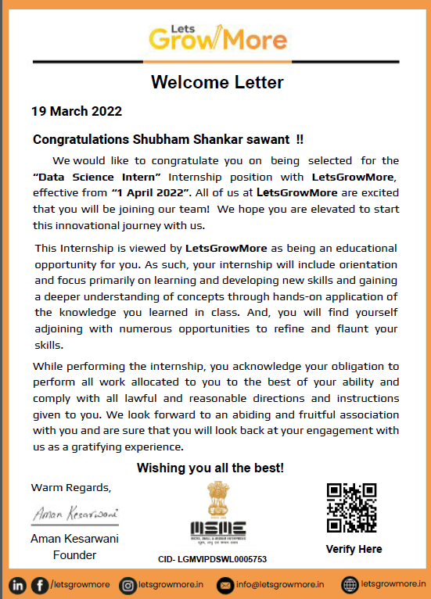
Offer Letter

Slide 5
Schedule of internship
Duration : 1st April 2022 to 1st May 2022
WEEK 1: 1st April 2022 to 7th April 2022
Python introduction and Basics of Python
WEEK 2:
Python array, Mathematical and trigonometric functions using numpy and python functions

Slide 6
WEEK 3: OOPs (Class and objects, Inheritance, Polymorphism, operator overloading and overriding, method overloading and overriding), core project.
WEEK 4:
Intro to Machine Learning and its Libraries and Project Building

Slide 7
Technology Used
Python
Python Libraries :
Numpy
Pandas
Matplotlib
Machine Learning

Slide 8
Tools Used
PyCharm
PyCharm is a dedicated Python Integrated Development Environment (IDE) providing a wide range of essential tools for Python developers, tightly integrated to create a convenient environment for productive Python, web, and data science development.
Google Colab
Collaboratory, or “Colab” for short, is a product from Google Research. Colab allows anybody to write and execute arbitrary python code through the browser, and is especially well suited to machine learning, data analysis and education.

Slide 9
Problem Statement
Create a Image to Pencil Sketch using python and Machine Learning

Slide 10
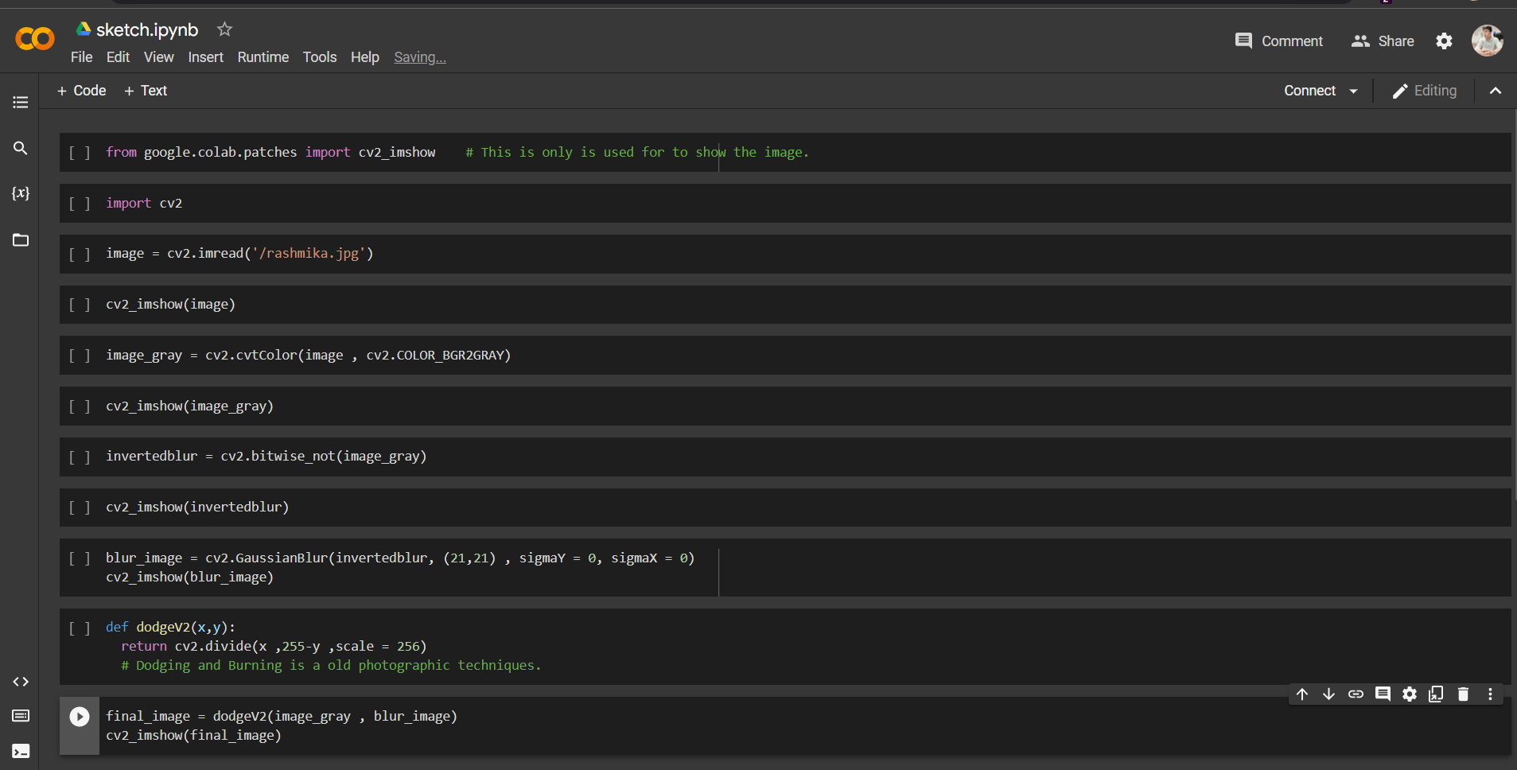

Slide 11
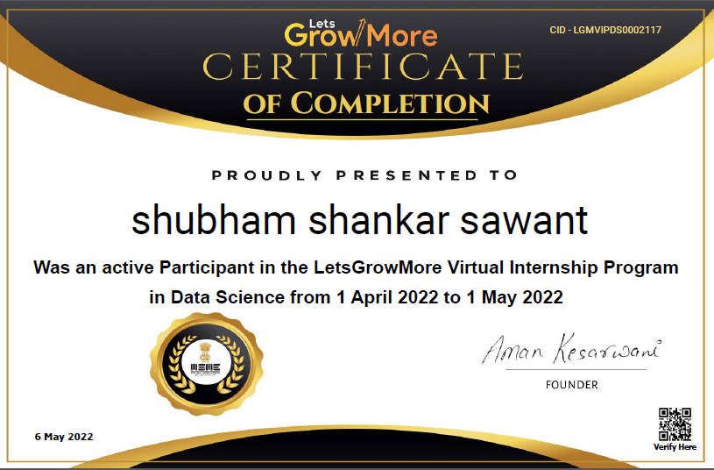
Internship Certificate Of Completion

Slide 12
Conclusion
Hence, In this internship I have learned the tools and technology related to python and machine learning, which helps me to build the project.
In this project I have learned how to perform various operations on dataset such as Analyze Data, visualize Data etc.

Slide 13
Thank You!!

